Slide 1
Utilizing JavaScript as an Assembler for an Audio Programming Language
Gary Reichard

Slide 2
Introduction
Is JavaScript a high-level language or the assembly language of the web?

Slide 3
But….Assemblers are architecture and processor specific….
Wikipedia definition-
An assembly language is a low-level programming language for a computer, or other programmable device, in which there is a very strong correspondence between the language and the architecture’s machine code instructions.

Slide 4
Every processor has it’s own assembler and they are very specific.
But the browser’s JavaScript VM is what runs the “new machine code”
There’s only one processor architecture…..
It’s the Web!

Slide 5
Mozilla asm.js and OdinMonkey
Emscripten, Mandreel, Cheerp
CoffeeScript
Google’s Native Client

Slide 6
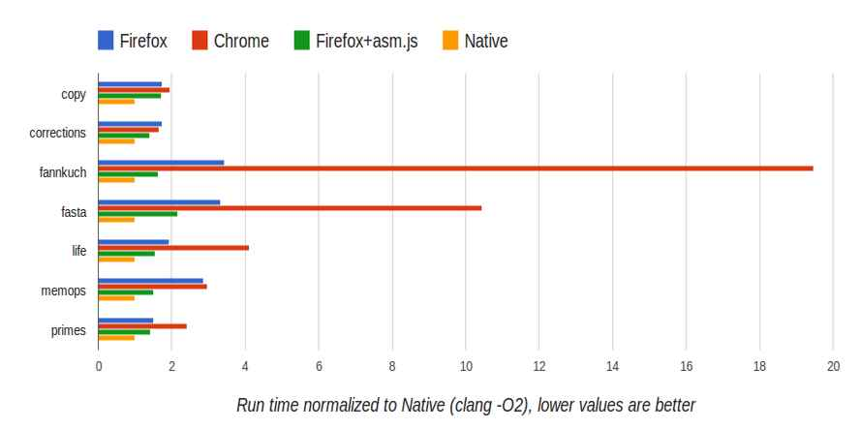

Slide 7
Solution or Objective:
Create a language to be parsed and target it to JavaScript for execution in a browser.
An audio programming language!

Slide 8
Implementation:
Create a music notation; a BNF grammar
Load and parse from a client side file
Interpret the results into JavaScript.
Output the executed code visually and with sound in a browser.

Slide 9
Milestones
Report on structure of input language, including a formal grammar
Design document for all the software of the project (diagrams and text)
Demonstration of partially working web app (complete look and feel; bugs, missing features)

Slide 10
QUESTIONS?

Slide 11
Spoiler Alert !!!!!! Milestone 1
<note> ::= <natural> <modifier> <duration> <octave>
<natural> ::= ‘A’ | ‘B’ | ‘C’ | ‘D’ | ‘E’ | ‘F’ | ‘G’
<modifier> ::= ‘#’ | ‘b’ | ‘n’ | ‘d#’ | ‘db’
<duration> ::= -3 | -2 | -1 | 1 | 2 | 4 | 8 | 16 | 32 | 64 | 128 | 256
<octave> ::= ‘C-1’ | ‘C0’ | ‘C1’ | ‘C2’ | ‘C3’ | ‘C4’ | ‘C5’ | ‘C6’

